Slide 1
Clifford Algebras
Christopher M. Donohue (CMD)

Slide 2
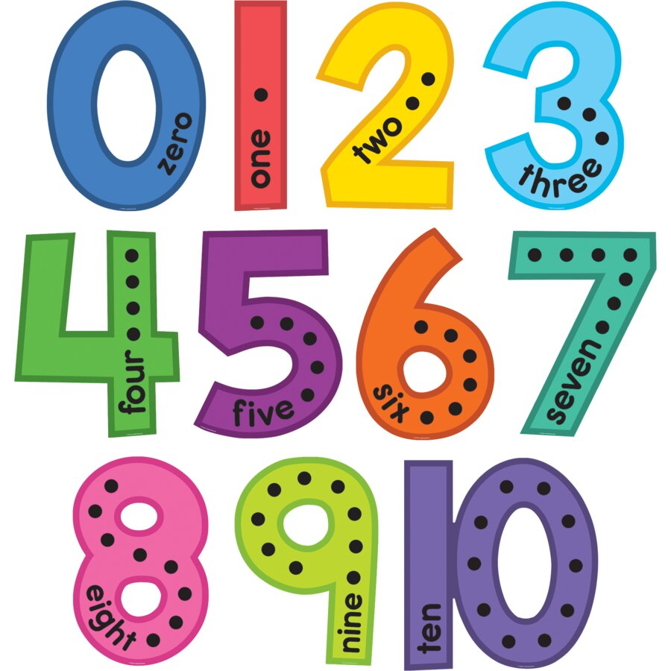
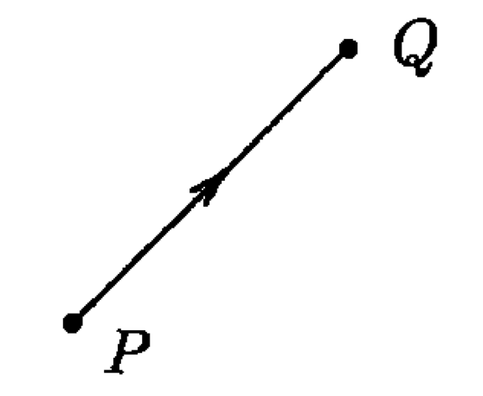
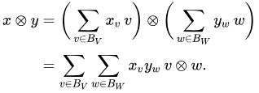

Tensor Algebra
We all know scalar fields: $𝔽$ ($ℝ$ or $ℂ$)
We all know Vector spaces: $V$
We can take a direct product of vector spaces vector space:
  $v⊗w∈V⊗W$
  Can treat just like a Cartesian pair $(x,y)$ or complex numbers
In general, $T^{n}\left(V\right)=V⊗V…⊗V$
Tensor Algebra: $T\left(V\right)=⊕_{n=0}^{∞}T^{n}\left(V\right)$
  $𝔽⊕V⊕\left(V⊗V\right)⊕\left(V⊗V⊗\right)⊕…$
  $2+\vec{v}+\vec{v}⊗\vec{u}+\vec{v}⊗\vec{w}⊗\vec{u}+…$

Slide 3

A Bunch of Definitions 😴
A subalgebra $I$ of algebra $A$ is a two-sided ideal if $∀i∈I, ∀a∈A$, $ir∈I$ and $ri∈I$
We can generate a two-sided ideal from a subset $S$ by
  $ASA=\left\langle S\right\rangle =\left\{\sum_{i=1}^{n}{r_{i}s_{i}t_{i}}|r_{i},t_{i}∈A, s_{i}∈S\right\}$
The quotient algebra $A/I$ is the set of all equivalence classes where the equivalence relation is defined as $a\sim b⟺a−b∈I$
A symmetric bilinear is map $g:V⊗V→𝔽$ such that
  $$g\left(v,u\right)=g\left(u,v\right), ∀v,u∈V$$
A Quadratic form is then $Q\left(v\right)=g(v,v)$
  Effectively, it’s a degree 2 polynomial
  $g\left(v,u\right)=\frac{1}{2}(Q\left(v+u\right)−Q\left(v\right)−Q\left(u\right))$

Slide 4


Clifford Algebras Definition
Let $V$ be a vector space over a field $𝔽$
Let $Q(v)$ be a quadratic form
We have the ideal: $I=\left\langle v⊗v−Q\left(v\right)𝕀\right\rangle$
  Or $I=⟨v⊗u+u⊗v−2g\left(u,v\right)𝕀⟩$
$$Cℓ\left(V,Q\right)=T(V)/I$$
But practically, what does that actually mean???

Slide 5

Interpreting the Definition
$Cℓ\left(V,Q\right)=T(V)/\left\langle v⊗v−Q\left(v\right)𝕀\right\rangle$
$v⊗v−Q\left(v\right)𝕀∈I$
  $$v⊗v\sim Q\left(v\right)𝕀$$
Consequently, we can simplify tensor products
  $v⊗v⊗w\sim Q\left(v\right)w$
$\left(u+v\right)⊗\left(u+v\right)\sim Q\left(u+v\right)$ $⇒u⊗v+v⊗u\sim Q\left(u+v\right)−Q\left(u\right)−Q\left(v\right)=2B\left(u,v\right)$
Consequently, the ordering of tensor products can always get flipped
  $$u⊗v\sim −v⊗u+2B(u,v)$$

Slide 6

Example of Clifford Algebra
Let $V=span\left(e_{1},e_{2}\right)=\left\{αe_{1}+βe_{2} | α,β∈ℝ\right\}≅ℝ^{2}$
We have the quadratic form: $Q\left(αe_{1}+βe_{2}\right)={2α}^{2}−3αβ−β^{2}$
  $Q\left(e_{1}\right)=2$
  $Q(e_{2})=−1$
  $Q\left(e_{1}+e_{2}\right)−Q\left(e_{1}\right)−Q(e_{2})=−3$
Consider an element of the tensor algebra:
  $e_{1}e_{2}e_{1}e_{2}$ ~ $e_{1}e_{2}(−e_{2}e_{1}−3)$ ~ $e_{1}e_{1}−{3e}_{1}e_{2}$~ $2−3e_{1}e_{2}$
Effectively the Clifford algebra can be written as linear combinations of $1, e_{1}, e_{2}, e_{1}e_{2}$
  $Cℓ\left(v,Q\right)=\{a+be_{1}+ce_{2}+de_{1}e_{2}|a,b,c,d∈ℝ\}$
Any higher order tensor product will get reduced down through the equivalence relations

Slide 7


Basis Dependent Formulation
The quadratic form can be written as:
  $Q\left(α_{1}v_{1}+…+α_{n}v_{n}\right)=\left(\begin{matrix}α_{1} & … & α_{n}\end{matrix}\right)A\left(\begin{matrix}α_{1} \\ ⋮ \\ α_{n}\end{matrix}\right)$, where $A=A^{T}$
By Sylvester’s Theorem: $∃S$ such that
$S^{T}AS=diag(1,1,…,1,−1,…,−1,0,…,0)$
$Cℓ_{p,q}(ℝ)$ can be written in a basis dependent way
  $e_{i}^{2}=1$ for $1≤i≤p$
  $e_{i}^{2}=−1$ for $p+1≤i≤p+q$
  $e_{i}e_{j}=−e_{j}e_{i}$
Then construct the Clifford Algebra from the linear combination of the possible product of basis vectors
p
q
t

Slide 8
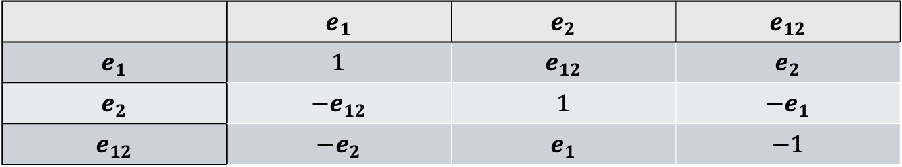


$$Cℓ_{2,0}(ℝ)$$
 | $$e_{1}$$ | $$e_{2}$$ | $$e_{12}$$
$$e_{1}$$ | $$1$$ | $$e_{12}$$ | $$e_{2}$$
$$e_{2}$$ | $${−e}_{12}$$ | $$1$$ | $${−e}_{1}$$
$$e_{12}$$ | $${−e}_{2}$$ | $$e_{1}$$ | $$−1$$
A basis of 4 elements:
  $1∈ℝ$, scalars
  $e_{1},e_{2}∈ℝ^{2}$, vectors
  $e_{12}≡e_{1}e_{2}∈∧ℝ^{2}$, bivectors
Can break up into even and odd subalgebras:
  Odd: $Cℓ_{2}^{−}=ℝ^{2}$, ${(xe}_{1}+ye_{2})$
  Even: $Cℓ_{2}^{+}=ℝ⊕∧^{2}ℝ^{2}≅ℂ$, $(a+be_{12})$

Slide 9
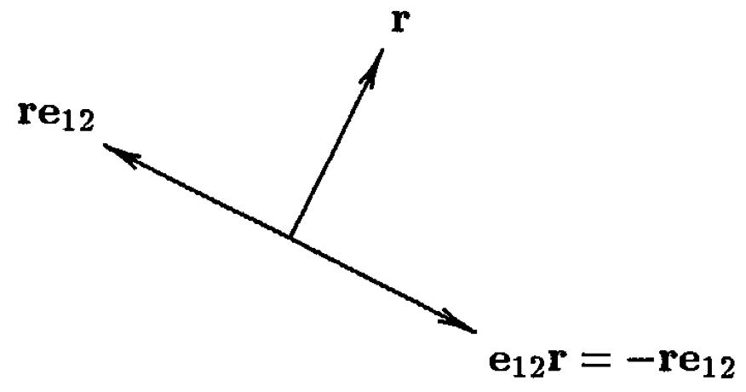
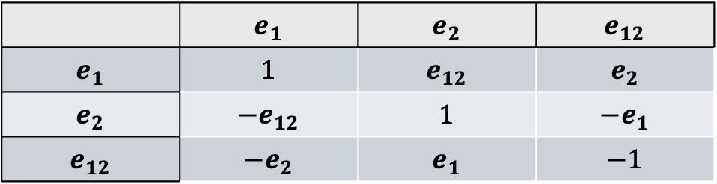

$$Cℓ_{2,0}(ℝ)$$
 | $$e_{1}$$ | $$e_{2}$$ | $$e_{12}$$
$$e_{1}$$ | $$1$$ | $$e_{12}$$ | $$e_{2}$$
$$e_{2}$$ | $${−e}_{12}$$ | $$1$$ | $${−e}_{1}$$
$$e_{12}$$ | $${−e}_{2}$$ | $$e_{1}$$ | $$−1$$
If we have a vector, $\vec{r}=xe_{1}+ye_{2}$, then $\vec{r}e_{12}=xe_{2}−ye_{1}$
  Rotates the vector ${90}^{0}$ counter-clockwise
General rotator: $s=1\cos{\frac{φ}{2}}+e_{12}\sin{\frac{φ}{2}}$
  Rotate by angle ɸ: $\vec{r}→s^{−1}\vec{r}s$
$Spin\left(2\right)=\{s∈Cℓ_{2}^{+}|s \overline{s}=1\}$
  $\frac{Spin\left(2\right)}{\left\{±1\right\}}≅SO(2)$

Slide 10
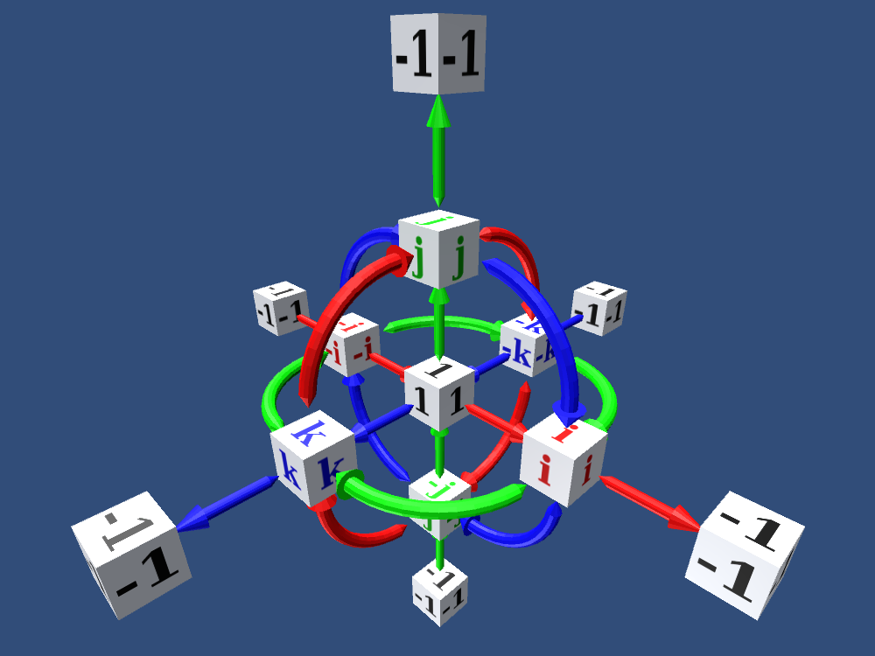
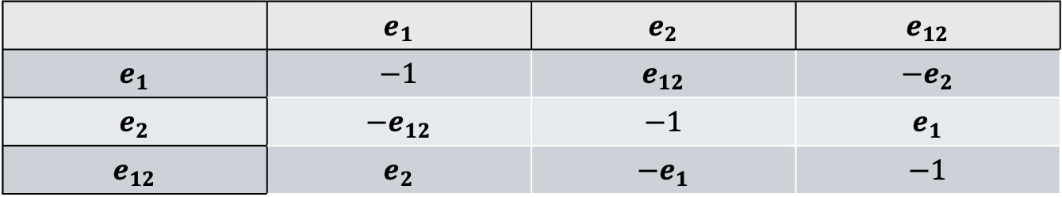


$$Cℓ_{0,2}(ℝ)$$
 | $$e_{1}$$ | $$e_{2}$$ | $$e_{12}$$
$$e_{1}$$ | $$−1$$ | $$e_{12}$$ | $${−e}_{2}$$
$$e_{2}$$ | $${−e}_{12}$$ | $$−1$$ | $$e_{1}$$
$$e_{12}$$ | $$e_{2}$$ | $${−e}_{1}$$ | $$−1$$
Make $e_{1}→i$, $e_{2}→j$, $e_{1}e_{2}→k$, you get back the Quaternions
$Cℓ_{0,2}≅ℍ$

Slide 11
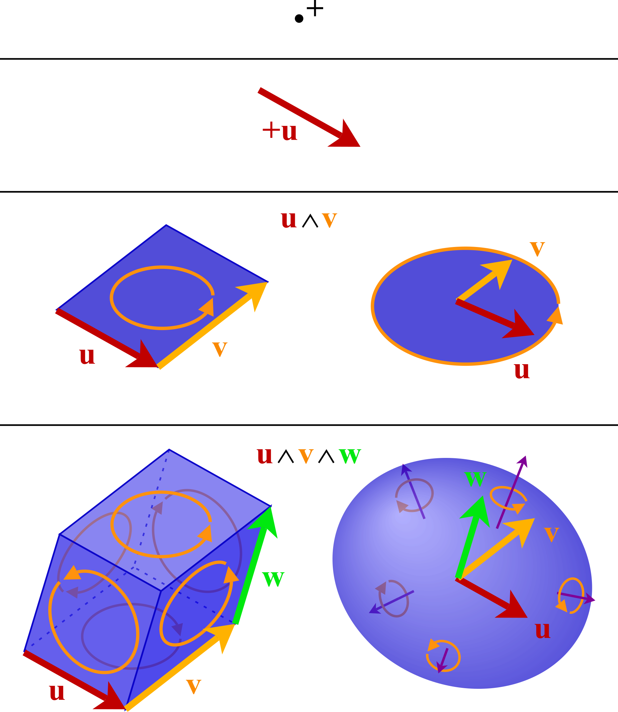

Clifford Product
$\vec{a}=a_{i}e_{i}$, $\vec{b}=b_{i}e_{i}$
$\vec{a}\vec{b}=a⋅b+a∧b$
  Inner Product :$a⋅b=a_{1}b_{1}+a_{2}b_{2}$
  Exterior Product: $a∧b=\left(a_{1}b_{2}−a_{2}b_{1}\right)e_{12}$
The exterior product can be interpreted as an oriented area
In higher dimensions:
  $\vec{a}∧\vec{b}=\sum_{i<j}{(a_{i}b_{j}−a_{j}b_{i})(e_{i}∧e_{j})}$
Pretty naturally comes from rules laid out:
  $a=a_{1}e_{1}+a_{2}e_{2}$, $b=b_{1}e_{1}+b_{2}e_{2}$
  $ab=\left(a_{1}e_{1}+a_{2}e_{2}\right)\left(b_{1}e_{1}+b_{2}e_{2}\right)=$
  $$a_{1}b_{1}e_{1}e_{1}+a_{1}b_{2}e_{1}e_{2}+a_{2}b_{1}e_{2}e_{1}+a_{2}b_{2}e_{2}e_{2}=\left(a_{1}b_{1}+a_{2}b_{2}\right)+\left(a_{1}b_{2}−a_{2}b_{1}\right)e_{1}e_{2}$$

Slide 12
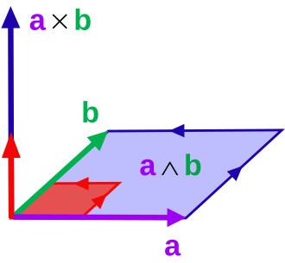


$$Cℓ_{3,0}(ℝ)$$
$Cℓ_{3}$ is an eight dimensional algebra
  $1$, the scalar
  $e_{1},e_{2},e_{3}$, the vectors
  $e_{1}e_{2},e_{1}e_{3}, e_{2}e_{3}$, bivectors
  $e_{1}e_{2}e_{3}$, volume element
An arbitrary element of $Cℓ_{3}$:
  $α+\vec{a}+\vec{b}e_{123}+βe_{123}$, $α, β∈ℝ, \vec{a},\vec{b}∈ℝ^{3}$
The exterior product clearly lines up with the cross product
  $\vec{a}=a_{1}e_{1}+a_{2}e_{2}+a_{3}e_{3}$, $\vec{b}=b_{1}e_{1}+b_{2}e_{2}+b_{3}e_{3}$
  $\vec{a}∧\vec{b}=\left(a_{1}b_{2}−a_{2}b_{1}\right)e_{1}e_{2}+\left(a_{3}b_{1}−a_{1}b_{3}\right)e_{3}e_{1}+\left(a_{2}b_{3}−a_{3}b_{2}\right)e_{2}e_{3}$

Slide 13



$Cℓ_{3,0}(ℝ)$ and Maxwell’s Equations
With a cleaner way of expressing the cross product, some physics equations simplify down. For instance
$$\vec{∇}⋅\vec{E}=ρ$$
$$\frac{∂\vec{E}}{∂t}+\vec{∇}⋅\vec{B}=−\vec{J}$$
$$\frac{∂\vec{B}}{∂t}+\vec{∇}×\vec{E}=0$$
$$\vec{∇}⋅\vec{B}=0$$
$$\left(\frac{∂}{∂t}+\vec{∇}\right)\left(\vec{E}+\vec{B}e_{123}\right)=ρ−\vec{J}$$

Slide 14


$Cℓ_{3,0}(ℝ)$, Breaking Things Up
Just like with $Cℓ_{2}$, we can try to identify different parts of $Cℓ_{3}$ with things we already know
$e_{1}^{2}=1$, $e_{2}^{2}=1$, $e_{3}^{2}=1$, $e_{123}^{2}=−1$
$e_{123}$ commutes with all elements of $Cℓ_{3}$
$e_{1}e_{2}=−e_{2}e_{1}=e_{123}e_{3}$, $e_{3}e_{1}=−e_{1}e_{3}=e_{123}e_{2}$, $e_{2}e_{3}=−e_{3}e_{2}=e_{123}e_{1}$
This should look familiar. It’s the relations between the Pauli Matrices
$e_{1}≅σ_{1}=\left(\begin{matrix}0 & 1 \\ 1 & 0\end{matrix}\right)$, $e_{2}≅σ_{2}=\left(\begin{matrix}0 & −i \\ i & 0\end{matrix}\right)$, $e_{3}≅σ_{3}=\left(\begin{matrix}1 & 0 \\ 0 & −1\end{matrix}\right)$, $e_{123}≅i𝕀$
$⇒Cℓ_{3}≅Mat(2,ℂ)$

Slide 15

$Cℓ_{3,0}(ℝ)$, Breaking Things Up
The Center: $Z\left(Cℓ_{3}\right)=\left\{x+ye_{123}\right\}≅ℂ$
Even subalgebra: $Cℓ_{3}^{−}=\left\{w+xe_{23}+ye_{31}+ze_{12} | w,x,y,z∈ℝ\right\}≅\left\{w+xiσ_{1}+yiσe_{31}+ziσ_{3} | w,x,y,z∈ℝ\right\}≅\left(\begin{matrix}w+iz & ix+y \\ ix−y & w−iz\end{matrix}\right)$
$−e_{23}→i, −e_{31}→j,−e_{12}→k⇒Cℓ_{3}^{−}≅ℍ$
$Cℓ_{3}≅ℂ⊗ℍ$

Slide 16


$Cℓ_{3,0}(ℝ)$, Involutions
For $u={\left\langle u\right\rangle }_{0}+{\left\langle u\right\rangle }_{1}+{\left\langle u\right\rangle }_{2}+{\left\langle u\right\rangle }_{3}∈Cℓ_{3}$
  Grade Involution: $\hat{u}={\left\langle u\right\rangle }_{0}−{\left\langle u\right\rangle }_{1}+{\left\langle u\right\rangle }_{2}−{\left\langle u\right\rangle }_{3}$
  Reversion: $\tilde{u}={\left\langle u\right\rangle }_{0}+{\left\langle u\right\rangle }_{1}−{\left\langle u\right\rangle }_{2}−{\left\langle u\right\rangle }_{3}$
  Clifford Conjugation: $\overline{u}={\left\langle u\right\rangle }_{0}−{\left\langle u\right\rangle }_{1}−{\left\langle u\right\rangle }_{2}+{\left\langle u\right\rangle }_{3}$
With $σ_{i}≅e_{i}$, for $u≅\left(\begin{matrix}a & b \\ c & d\end{matrix}\right)$
  $\hat{u}≅\left(\begin{matrix}d^{∗} & −c^{∗} \\ −b^{∗} & a^{∗}\end{matrix}\right)$, $\tilde{u}≅\left(\begin{matrix}a^{∗} & c^{∗} \\ b^{∗} & d^{∗}\end{matrix}\right)=u^{†}$, $\overline{u}≅\left(\begin{matrix}d & −b \\ −c & a\end{matrix}\right)∝u^{−1}$
Inverse: $u^{−1}=\frac{\overline{u}}{u\overline{u}}$, $u\overline{u}∈Z(Cℓ_{3})$ so like dividing by complex number

Slide 17
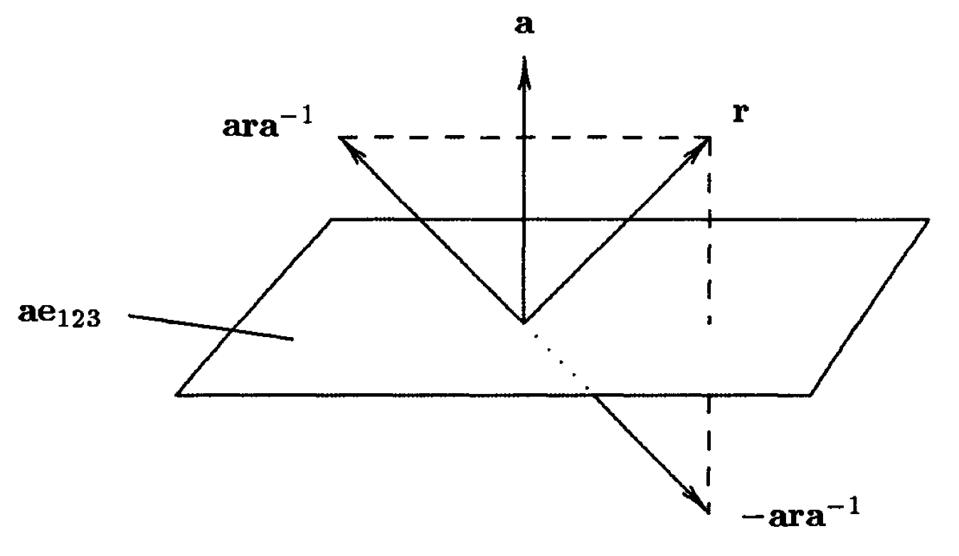
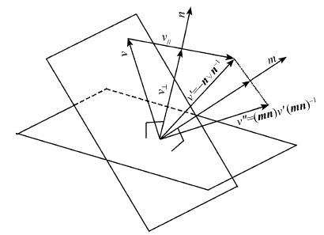


$Cℓ_{3,0}(ℝ)$, Rotation
For $\vec{a}=a_{1}e_{1}+a_{2}e_{2}+a_{3}e_{3}$, $\vec{r}=r_{1}e_{1}+r_{2}e_{2}+r_{3}e_{3}$
$\vec{a}\vec{r}{\vec{a}}^{−1}$ and $\vec{r}$ are symmetric about $\vec{a}$
$−\vec{a}\vec{r}{\vec{a}}^{−1}$ is obtain by taking and reflecting it across the plane ⟂ to a
  $$\vec{a}\vec{r}+\vec{r}\vec{a}=2\vec{a}⋅\vec{r}⇒$$
  $$−\vec{a}\vec{r}{\vec{a}}^{−1}=\vec{r}−\frac{2\left(\vec{a}⋅\vec{r}\right)}{a^{2}}\vec{a}$$
If you do this twice: $\vec{r}→\vec{b}\vec{a}\vec{r}{\vec{a}}^{−1}{\vec{b}}^{−1}$ rotates $\vec{r}$ around an axis ⟂ to $\vec{a}$ and $\vec{b}$ by twice the angle between a and b

Slide 18

$Cℓ_{3,0}(ℝ)$, Rotation
This gives us a sense for the general formula for 3D rotations
If we want to rotate a vector $\vec{r}$ about an axis $\vec{a}$ an angle $α=|\vec{a}|$:
$$\vec{r}→s\vec{r}s^{−1}$$
Where $s=exp⁡(\frac{1}{2}\vec{a}e_{123})$
This is an element of
$Spin\left(3\right)=\{s∈Cℓ_{3}|\tilde{s}s=1,\overline{s}s=1\}$
Translating that into matrices
$Spin\left(3\right)≅SU\left(2\right)=\{s∈Mat(2,ℂ)|s^{†}s=1,\det\left(s\right)=1\}$

Slide 19

Review Schrödinger-Pauli Equation
Since the Pauli matrices are popping up, it might make sense to connect this back to Quantum Mechanics
$iℏ\frac{∂ψ}{∂t}=\frac{1}{2m}\left[{\left(−iℏ∇−e\vec{A}\right)}^{2}\right]ψ−eVψ$
With $\vec{π}=\vec{p}−e\vec{A}$: $iℏ\frac{∂ψ}{∂t}=\frac{1}{2m}\left[(π^{2}−ℏe(\vec{σ}⋅\vec{B})\right]ψ−eVψ$
  $\vec{σ}⋅\vec{B}$ operates on two-component column matrices
Pauli spinors: $ψ\left(\vec{r},t\right)=\left(\begin{matrix}ψ_{1} \\ ψ_{2}\end{matrix}\right), ψ_{1},ψ_{2}∈ℂ$
You could instead write them as 2⨉2 matrices:
  $ψ=\left(\begin{matrix}ψ_{1} & 0 \\ ψ_{2} & 0\end{matrix}\right)$
The Pauli spinors form a left ideal of Mat(2,ℂ)
  $\left(\begin{matrix}u_{11} & u_{12} \\ u_{21} & u_{22}\end{matrix}\right)\left(\begin{matrix}ψ_{1} & 0 \\ ψ_{2} & 0\end{matrix}\right)=\left(\begin{matrix}φ_{1} & 0 \\ φ_{2} & 0\end{matrix}\right)$

Slide 20


Pauli Spinors in $Cℓ_{3}$
Since $Cℓ_{3}≅Mat(2,ℂ)$, we can translate Pauli spinors to $Cℓ_{3}$
Spinors, S, can be the minimal left ideal of $Cℓ_{3}$
  $ψ∈S, u∈Cℓ_{3}⇒uψ∈S$
The basis of S
  $f_{0}=\frac{1}{2}\left(1+e_{3}\right)≅\left(\begin{matrix}1 & 0 \\ 0 & 0\end{matrix}\right)$
  $f_{1}=\frac{1}{2}\left(e_{23}+e_{2}\right)≅\left(\begin{matrix}0 & 0 \\ i & 0\end{matrix}\right)$
  $f_{2}=\frac{1}{2}\left(e_{31}−e_{1}\right)≅\left(\begin{matrix}0 & 0 \\ −1 & 0\end{matrix}\right)$
  $f_{3}=\frac{1}{2}\left(e_{12}+e_{123}\right)≅\left(\begin{matrix}i & 0 \\ 0 & 0\end{matrix}\right)$
$f=f_{0}$ is the idempotent:, $f^{2}=f$ and $S=Cℓ_{3}f$

Slide 21

Pauli Spinors in $Cℓ_{3}$
Scalar products can be defined as
$$\tilde{ψ}φ≅\left(\begin{matrix}ψ_{1}^{∗} & ψ_{2}^{∗} \\ 0 & 0\end{matrix}\right)\left(\begin{matrix}φ_{1} & 0 \\ φ_{2} & 0\end{matrix}\right)=\left(\begin{matrix}ψ_{1}^{∗}φ_{1}+ψ_{2}^{∗}φ_{2} & 0 \\ 0 & 0\end{matrix}\right)$$
A Spinor operator can be written as
$$Ψ=ψ+\hat{ψ}≅\left(\begin{matrix}ψ_{1} & −ψ_{2}^{∗} \\ ψ_{2} & ψ_{1}^{∗}\end{matrix}\right)∈Cℓ_{3}^{+}$$
Spin is then $\vec{s}=Ψe_{3}\tilde{Ψ}$
Rewriting the SE equation:
$$iℏ\frac{∂Ψ}{∂t}=\frac{1}{2m}π^{2}Ψ−\frac{ℏe}{2m}\vec{B}Ψe_{3}−eVΨ$$
  Shows the quantization direction $e_{3}$ of the spin
  Can transform ${\vec{B}}^{′}=s\vec{B}s^{−1}$, $Ψ^{′}=sΨ$ then multiple on both sides by $s^{−1}$ to get the equation back but with a new quantization direction

Slide 22


$$Cℓ_{1,3}(ℂ)$$
Now, $e_{0}^{2}=1$, $e_{1}^{2}=−1,e_{2}^{2}=−1,e_{3}^{2}=−1$
In $Cℓ_{3}$, we identified the basis vectors with the Pauli Matrices: $e_{i}≅σ_{i}$
For $Cℓ_{1,3}$, we identified the basis elements with the gamma matrices: $e_{μ}≅γ_{μ}$
  Therefore $\left\{γ_{μ},γ_{ν}\right\}=2η_{μν}𝕀$ so $Cℓ_{1,3}≅Mat(2,ℍ)$
Similarly, the Lorentz groups $O(1,3)$, $SO(1,3)$, $SO_{+}(1,3)$ are doubly covered by
  $Pin\left(1,3\right)=\{s∈Cℓ_{1,3}^{+}∪Cℓ_{1,3}^{−}|s\tilde{s}=±1\}$
  $Spin\left(1,3\right)=\{s∈Cℓ_{1,3}^{+}|s\tilde{s}=±1\}$
  $Spin_{+}\left(1,3\right)=\left\{s∈Cℓ_{1,3}^{+} | s\tilde{s}=1\right\}≅SL\left(2,ℂ\right)$
A Lorentz transform $L∈O(1,3)$ is given by $L\left(x\right)=sx{\hat{s}}^{−1}$

Slide 23


$Cℓ_{1,3}(ℂ)$ and the Dirac Spinors
Dirac spinors are elements of the minimal left ideal of $Cℓ_{1,3}$
  $ψ∈Cℓ_{1,3}f$, $f=\frac{1}{2}(1+γ_{0})(1+iγ_{1}γ_{2})$
  $ψ=ψ_{1}f_{1}+ψ_{2}f_{2}+ψ_{3}f_{3}+ψ_{4}f_{4}$
    $f_{1}=\frac{1}{4}\left(1+γ_{0}+iγ_{12}+iγ_{012}\right)=f$
    $f_{1}=\frac{1}{4}\left(−γ_{13}+iγ_{23}−γ_{013}+iγ_{013}\right)=−γ_{13}f$
    $f_{2}=\frac{1}{4}\left(γ_{3}−γ_{03}+{iγ}_{123}−iγ_{0123}\right)=−γ_{03}f$
    $f_{3}=\frac{1}{4}\left(γ_{1}−iγ_{2}−γ_{01}+iγ_{02}\right)=−γ_{01}f$
Still have left, right projection operators:
  $P_{L}=\frac{1}{2}(1+γ_{5})$, $P_{R}=\frac{1}{2}(1−γ_{5})$, where $γ_{5}=iγ_{0}γ_{1}γ_{2}γ_{3}$

Slide 24


$Cℓ_{1,3}(ℂ)$ and the Dirac Equation
Get a Spinor operator
  $\hat{u}={\left\langle u\right\rangle }_{0}−{\left\langle u\right\rangle }_{1}+{\left\langle u\right\rangle }_{2}−{\left\langle u\right\rangle }_{3}+{\left\langle u\right\rangle }_{4}$ (grade involution)
  $\overline{u}={\left\langle u\right\rangle }_{0}−{\left\langle u\right\rangle }_{1}−{\left\langle u\right\rangle }_{2}+{\left\langle u\right\rangle }_{3}+{\left\langle u\right\rangle }_{4}$ (Clifford-conjugation)
  $Φ=2(ψ+\overline{ψ})$
  $Ψ=\frac{1}{2}\left(Φ+\hat{Φ}\right)≅\left(\begin{matrix}ψ_{1} & −ψ_{2}^{∗} & ψ_{3} & ψ_{4}^{∗} \\ ψ_{2} & ψ_{1}^{∗} & ψ_{4} & −ψ_{3}^{∗} \\ ψ_{3} & ψ_{4}^{∗} & ψ_{1} & −ψ_{2}^{∗} \\ ψ_{4} & −ψ_{3}^{∗} & ψ_{2} & ψ_{1}^{∗}\end{matrix}\right)$
The Dirac Equation: $γ_{μ}\left(iℏ∂^{μ}−eA^{μ}\right)ψ=mcψ$
In terms of $Cℓ_{1,3}$: $∂Ψγ_{21}−e\vec{A}Ψ=mΨγ_{0}$

Slide 25

Clifford Algebra Sources
That’s all I got!
P. Lounesto. Clifford Algebras and Spinors, Second Edition. Cambridge University Press (2001)
J. Vaz & R.D. Rocha, Introduction to Clifford Algebras and Spinors, Oxford University Press (2016)

